Slide 1
2020 CalHome General
Program NOFA Webinar
California Department of Housing and Community Development
Notes:
Mauro

Slide 2
PRESENTERS
Kara Thomson
Conant Radcliffe
Gail Melendres
Brandon Bouldin
Specialist: Gabriella Navarro
Program Manager: Mauro Lara
Notes:
Mauro

Slide 3
AGENDA
What’s New and Reminders
Program Overview
Eligible Applicants
Eligible Activities
Threshold Review
Rating
Application and Portal Submission
Resolution
Questions
Notes:
Mauro

Slide 4
What’s New ?
New in 2020 NOFA
Geographic set asides defined in the NOFA.
Applicant’s can only apply for one county per application.
Define eligible applicant’s to include the duly constituted governing body of an Indian reservation or rancheria or a tribally designated housing entity, for purposes of the CalHome Program.
Electronic submission of Application.
Notes:
Mauro

Slide 5
REMINDERS
IMPORTANT REMINDERS
Application Deadline: October 29, 2020 by 11:59 p.m.
Selection of Activity type will open other worksheet tabs
Applications must be complete
Send Questions to: CalHome@hcd.ca.gov
Notes:
Mauro

Slide 6
PROGRAM OVERVIEW
Notes:
Conant
In Program Overview we’ll cover
Available funding,
Geographic Distribution of awards,
Funding by activity,
Funding amounts by activity,
And household income limits.

Slide 7
NOFA
Approximately $57 million available to fund Local Public Agencies or Nonprofit Corporations for eligible CalHome activities.
This NOFA will be governed by CalHome Program Guidelines (the “Guidelines”).
This NOFA is also subject to the requirements of the CalHome program authorized by Chapter 6 (commencing with Section 50650) of Part 2 of Division 31 of the Health and Safety (H&S) Code.
Notes:
Conant:
HCD is making approximately $57 million available to Local Public Agencies or Nonprofit Corporations for;
First-Time Homebuyer Mortgage Assistance (including the purchase of a home with an Accessory Dwelling Unit (ADU) or Junior Accessory Dwelling Unit (JADU))
2. Owner-Occupied Rehabilitation Assistance (including reconstruction and Rehabilitation of manufactured homes not on a permanent foundation, and construction, repair, reconstruction, or Rehabilitation of ADUs or JADUs)
Technical Assistance for Self-Help Housing Projects
Technical Assistance for Shared Housing Programs
Accessory Dwelling and Junior Accessory Dwelling Units - Assistance (including construction, repair, reconstruction, or Rehabilitation of ADUs or JADUs)
6. Homeownership Project Development Loans (including Predevelopment Costs and carrying costs during construction related to ADUs and JADUs)
The NOFA is governed by the CalHome Program Guidelines (the “Guidelines”). The Guidelines are available on HCD’s website at (link).
CalHome Is also subject to the requirements of the California Health and Safety Code
Chapter 6 (commencing with Section 50650) of Part 2 of Division 31 of the Health and Safety (H&S) Code.

Slide 8
NOFA Geographic Distribution
The Geographic Distribution will be as follows: Southern CA 45 percent including Kern, San Luis Obispo, San Bernardino and all other counties south. Northern CA 30 percent (remaining counties).
15 percent for Rural counties as defined in 25 CCR Section 7716
HCD will rate applications in accordance with Guidelines Section 7755, subd. (b).
Notes:
Conant:
1. Geographic Distribution of Funds – The Department’s goal will be for
Southern CA to receive 45 percent of the funds (Including Kern, San Luis Obispo, San Bernardino and all other counties south)
Northern CA to receive 30 percent of the funds (remaining counties), and
Rural Counties toreceive 15 percent of the CalHome funds
2. Rural Counties are defined in CalHome Guidelines Section 7716
3. CalHome program funds will be allocated through a competitive process. The applications will be rated in accordance with CalHome Guidelines Section 7755.

Slide 9
FUNDING AMOUNTS BY ACTIVITY
Activity | Minimum Application Amount | Maximum Application Amount
FTHB Mortgage Assistance | $500,000 | $5 Million
Owner Occupied Rehabilitation | $500,000 | $5 Million
ADU/JADU Programs | $500,000 | $5 Million
TA for Shared Housing Program | $100,000 | $300,000
TA for Self-Help Housing Projects | $100,000 | $500,000
Project Development Loan | $500,000 | $5 Million
Maximum award amount is per APPLICANT is $5M
Notes:
Conant:
The CalHome awards go from HCD to the Applicant. CalHome funds do not directly assist individual households.
Here we see the minimum and maximum amounts an applicant can apply for by CalHome activity.
You can see these amounts on Page 6 of the NOFA.
For
First Time Home Buyer Mortgage Assistance Loans
Owner Occupied Rehabilitation Loans
Accessory or Junior Accessory Dwelling Unit Loans
Homeownership Project Development Loans –
The minimum application amount is $500,000. (The exceptions are Technical Assistance for Self-Help Housing Projects or Technical Assistance for Shared Housing Programs)
The minimum application amount for a Technical Assistance Shared Housing Program Grant is $100,000.
The minimum application amount for a Technical Assistance Self Help Housing Project Grant is $100,000.
If an applicant is applying for more than one activity the minimum application amount is $600,000.
If you are applying for more than one activity, the maximum application amount is $5 million.
If you are applying for Technical Assistance for Self-Help Housing Projects, the maximum application amount is $500,000.
If you are applying for Technical Assistance for Shared Housing Programs, the maximum application amount is $300,000.

Slide 10
PER UNIT FUNDING LIMITS BY ACTIVITY
Activity | Funding Type | Minimum Amount | Maximum Amount
FTHB Mortgage Assistance | Loan | $1,000 | 40 percent of borrower’s purchase price not to exceed $100,000
Owner Occupied Rehabilitation Assistance | Loan | $1,000 | $75,000 except if home is in need of reconstruction then maximum will be $125,000 (Guidelines Section 7716, subd.(zz)(2)).
ADU/JADU Assistance | Loan | $1,000 | $100,000
Homeownership Project Development | Loan | $1,000 | $100,000
TA for Self-Help Housing Projects | Grant | $1,000 | $15,000 all expenses to be documented.
TA for Shared Housing Programs | Grant | $1,000 | $300,000 note this assistance does not assist individual units.
Notes:
Conant
Here we have the Minimum and Maximum Per Unit Funding Limits for CalHome loans and grants.
I wanted to emphasize CalHome assistance does not go directly to the individual household.
The minimum CalHome assisted Loan to a borrower will be $1,000.
For First-Time Homebuyer Assistance Loans
The maximum Loan amount will be 40 percent of the Borrower’s purchase price, up to a maximum of $100,000.
For Owner-Occupied Rehabilitation Assistance Loans
The maximum Loan amount will be $75,000, except if the unit needs reconstruction. Then the maximum loan amount will be $125,000.
Reconstruction is covered in Section 7716 (zz)(2) of the CalHome guidelines.
For Accessory and Junior Accessory Dwelling Unit along with Homeownership Project Development Loans
The maximum per-unit Loan amount will be $100,000.
If an Applicant is applying to fund a Homeownership Development Project with a Technical Assistance Self-Help Housing Grant,
the Applicant may apply for Technical Assistance at $15,000 per-unit in addition to the Homeownership Project Development amount.
For Technical Assistance for Self-Help Housing Projects Grants
The maximum per-unit Grant amount will be $15,000. All expenses should be documented.
For Technical Assistance for Shared Housing Programs Grants
The maximum Grant amount for Self-Help Housing Programs is $300,000.

Slide 11
HOUSEHOLD INCOME LIMITS
CalHome assists Households at or below 80 percent of AMI (in compliance with H&S Code, Section 50052.5, subd. (b))
Notes:
Conant:
We have talked about the funding limits CalHome applicants are eligible to receive. Here we cover the Income limits for those households receiving CalHome assistance.
The CalHome program recipients will assist Households at or below 80 percent of Area Median Income (in compliance with H&S Code, Section 50052.5, subd. (b)).
I have covered the Program Overview, now Brandon Bouldin will cover the Eligible Applicants section.

Slide 12
ELIGIBLE APPLICANTS
Notes:
Brandon

Slide 13
ELIGIBLE APPLICANTS
Local Public Agencies (including the duly constituted governing body of an Indian reservation, rancheria, or a tribally designated housing entity).
                and
Nonprofit Corporations (including a tribally designated housing entity).
All applicants must have sufficient organizational stability and capacity to administer the local programs and/or projects.
Notes:
Brandon
Assembly Bill 1010: would define the terms “local public agency” or “local government agencies” to include the duly constituted governing body of an Indian reservation or rancheria or a tribally designated housing entity, as specified, for purposes of the CalHome Program. The bill would also define the term “nonprofit corporations” to include a tribally designated housing entity, as specified, for purposes of the CalHome Program.

Slide 14
ELIGIBLE APPLICANTS
All eligible applicants must have:
    Operated as a housing program administrator AND
          Are authorized to engage in, or assist in, the operation of housing programs for households with low or very low income OR
          Are authorized to engage in, or assist in, the development of housing for households with low or very low income.
Notes:
Brandon
The eligible applicant types are Local public entities or nonprofit corporation.
Eligible applicants must have operated as a housing program administrator and is authorized to engage in, or assist in the operation of housing programs for household with low or very low income OR is authorized to engage in, or assist in the development of housing for households with low or very low income. The applicant must have the ability to preform the requirements of the activity or activities for which they are applying for.

Slide 15
ELIGIBLE APPLICANTS
Local Public Agencies: Activities are restricted to the applicants jurisdiction.
Nonprofits: Activities are restricted to those counties in which the applicant has operated a housing program within the last two years, or for which they have an existing 523 technical assistance services agreement with the USDA.
Notes:
Brandon

Slide 16
ELIGIBLE APPLICANTS
Local Public Agencies: A Local Public Agency may hire a nonprofit and for-profit consultants located and/or registered within or outside its Jurisdictional boundaries, including other counties within the state.
Out of county consultants shall meet the same requirements as in-county consultants.
Local Public Agencies may establish a consortium (provided there is a MOU between parties) with a single administrator.
Only one Local Public Agency shall apply on behalf of the other entities in a consortium and may serve all jurisdictions.
Notes:
Brandon

Slide 17
ELIGIBLE APPLICANTS
If a Local Public Agency will utilize an Administrative Subcontractor for Capability/Experience, there must be an agreement between the two parties provided with the application.
The Standard Agreement will be executed between the Department and the Awardee. The Administrative Subcontractor will not sign the Standard Agreement.
Nonprofit corporations will not be able to utilize Administrative Subcontractors.
Notes:
Brandon

Slide 18
ELIGIBLE APPLICANT EXPERIENCE
Applicants or their Administrative Subcontractors need to demonstrate experience as a housing program administrator for a minimum of two years prior to the date of application.
              AND
For each activity applied for, the applicant or their administrative subcontractors must demonstrate a minimum of two years experience within four calendar years immediately preceding the date of the application.
Notes:
Brandon

Slide 19
ELIGIBLE APPLICANT EXPERIENCE
Local Public Agencies must demonstrate sufficient organization stability and capacity to administer the Local Programs and/or Projects.
This requirement can be met by submitting documents such as organizational charts, resumes, statements of qualifications or other documentation specified in the application. (See salmon colored cells).
Notes:
Brandon

Slide 20
ELIGIBLE APPLICANT EXPERIENCE
Nonprofit Corporation must submit proof that the exempt purpose for the two years prior to the date of the application include the activity for which is being applied for.
A Nonprofit Corporation must submit the two most recent years financial statements, one year must be audited. This is needed to demonstrate financial stability.
Notes:
Brandon

Slide 21
ELIGIBLE APPLICANT EXPERIENCE
Applicants that were previously awarded CalHome Grants shall submit all outstanding reports from the past two years to the Department by the application date.
Failure to submit the reports by the application date will result in the Application being ineligible for a CalHome award under this NOFA.
Applicants may email: CalHomeReports@hcd.ca.gov to obtain status on previous reports.
Notes:
Brandon

Slide 22
ELIGIBLE ACTIVITIES
Notes:
Gabby
Hi this is Gabby Navarro and I will be covering the next 2 sections of the PPT Eligible Activities and Threshold.

Slide 23
FTHB MORTGAGE ASSISTANCE
Gap financing for households with income levels at or below 80 percent of Area Median Income (AMI).
Homebuyer Education will be reimbursed in the form of a Grant from HCD to the Awardee in the amount not to exceed $250 per assisted unit.
Notes:
Gabby
First-Time Homebuyer Mortgage Assistance (including the purchase of homes with ADUs or JADUs and including Manufactured Housing, are Loans from the Awardee to individual Households at or below 80 percent of Area Median Income or better known as AMI. These funds can only be used as Gap Financning. Please see page 4 and 8 of the NOFA for further details about FTHB Mortgage Assistance.
Homebuyer Education (Guidelines Section, 7729 subd. (b)) will be reimbursed in the form of a Grant from HCD to the Awardee in an amount not to exceed $250 per assisted unit. The class can be an online class that meets the requirements.

Slide 24
OWNER OCCUPIED REHABILITATION
Includes repair, full reconstruction, or the addition of an Accessory Dwelling Unit or Junior Accessory Dwelling Unit (ADU or JADU).
Gap loans to households at or below 80 percent AMI.
Manufactured Housing is also eligible, including replacement of a manufactured home, located in a Mobilehome park or elsewhere.
Notes:
Gabby
Owner-Occupied Rehabilitation Assistance (including repair, full reconstruction, or the addition of an ADU or JADU, the funding is a Grant to the Awardee for Loans to individual Households at or below 80 percent of AMI .(in Manufactured Housing is also eligible, including replacement of a manufactured home, whether located in a Mobilehome Park or elsewhere (Guidelines Section 7716, subd. (s)(3) and Guidelines Section 7733, subd. (e)).
CalHome funds, for the purposes of this activity, can only be used as gap financing

Slide 25
OWNER OCCUPIED REHABILITATION
All assisted units shall have After-Rehabilitation Values (Guidelines Section 7716, subd. (f)) at or below the current local median sales price of a single-family home (Guidelines Section 7734, subd. (a)).
Recipients may use the most recent median sales price, by county, posted at the California Association of Realtors website at https://www.car.org/en/marketdata/data/countysalesactivity.
Notes:
Gabby
Owner-Occupied Rehabilitation Assistance
All assisted units shall have After-Rehabilitation shall be at or below the current local median sales price of a single-family home (Guidelines Section 7734, subd. (a)). Recipients may use the most recent median sales price, by county, posted at the California Association of Realtors website at https://www.car.org/en/marketdata/data/countysalesactivity. However, if prices have significantly changed, Recipients may request HCD approval to use different limits based on a local calculation of median values (Guidelines Section 7735, subd. (b)).

Slide 26
TECHNICAL ASSISTANCE FOR SHARED HOUSING PROGRAM
Operators of Shared Housing Programs will directly provide match services to “seekers” with “providers”, where the providers are homeowners who occupy their homes as their principal place of residence
Notes:
Gabby
Technical Assistance for Shared Housing Programs these funds are Grants from the department to Awardee to operator a Shared Housing Programs that will directly provide match services to “seekers” with “providers”, where the providers are homeowners who occupy their homes as their principal place of residence

Slide 27
TECHNICAL ASSISTANCE FOR SELF-HELP HOUSING PROJECTS
Commencing with Guidelines Section 7736, in which the Applicant organization will be directly providing the services required in Section 7738 (next slide will list these services).
Activity can be combined on the application with Homeownership Project Development Loan.
Notes:
Gabby
Projects (commencing with Guidelines Section 7736) in which the Applicant organization will be directly providing the services required in Guidelines Section 7738. We will see these services listed on the next slide.
Homebuyer Education (Guidelines Section 7729, subd. (b)) will be reimbursed in the form of a Grant from HCD to the Recipient in an amount not to exceed $250 per assisted unit.

Slide 28
TECHNICAL ASSISTANCE FOR SELF-HELP HOUSING PROJECTS
Section 7738 Administration Requirements
Program Marketing
Recruitment of Homebuyers and selection criteria
Income limits for participation and income determination procedures
Criteria for Homebuyer participation in the program including: Residency requirements, Credit Requirements and a process of providing reasonable accommodations to persons with a disability
List of activities to be performed by self-help participants
Construction training plan
Homeownership training plan
NOTE: A home assisted with Self-Help TA shall not be sold at a price that exceeds its appraised value. The Awardee may request an advance of up to 25 percent of the total Grant amount, the Awardee must submit a certification that they do no have the available funds to initiate the project.
Notes:
Gabby
Per Section 7738. here are Administration requirements for Self-help TA. ( The Recipient shall develop and employ Self-Help Technical Assistance Program Guidelines submitted to and approved by the Department as addressing the following topics: (1) Program Marketing (2) Recruitment of Homebuyers and selection criteria Department of Housing and Community Development 25 of 44 CalHome Program Guidelines (3) Income limits for participation and income determination procedures (4) Criteria for Homebuyer participation in the program including: (A) Residency requirements (B) Credit requirements (C) Process of providing reasonable accommodations to persons with a disability (5) List of activities to be performed by self-help participants (6) Construction training plan (7) Homeownership training plan (b)
PLEASE NOTE: A home assisted with Self-Help Technical Assistance shall not be sold at a price that exceeds its appraised value;
An Awardee may request an advance not to exceed 25% of the total grant amount Awarded. The Awardee must submit a certification that they do not have available funds to initiate the project.

Slide 29
ADU/JADU PROGRAM
Loans for ADU/JADU construction, reconstruction, repair, or Rehabilitation.
Households at or below 80 percent of AMI.
CalHome funds, for the purposes of this activity, can only be used as gap financing.
Notes:
Gabby
ADU/JADU Programs these are grant funds from the Department to the awardee and then loans from the awardee to individual households at or below 80%AMI. These funds can only be used for gap financing. As you can see on the slide these funds can be used for Construction, reconstruction, repair or rehabilitation.

Slide 30
HOMEOWNERHIP PROJECT DEVELOPMENT LOANS
Loans to the Applicants to be used for land acquisition, Predevelopment Costs, and on-site improvements, including costs related to ADUs and JADUs (unit construction is not an eligible expense).
Projects are ineligible to receive CalHome funds if construction work has begun or will begin prior to the date HCD executes the Standard Agreement with the Recipient and all conditions have been satisfied.
Construction work includes grading, site preparation (with the exception of demolition or clearing properties), or site improvements intended for public dedication (Guideline Section 7718, subd. (c)).
Notes:
Gabby
Homeownership Project Development Loans (Guidelines Section 7746) for conditional awards of development Loans to the Applicants to be used for land acquisition, Predevelopment Costs, and on-site improvements, including costs related to ADUs and JADUs . Please not (unit construction is not an eligible expense).
CalHome funds, for the purposes of this activity, can only be used as gap financing
(Guidelines Section 7749).
Note: Proposed projects are ineligible to receive CalHome funds if construction work has begun or will begin prior to the date HCD executes the Standard Agreement with the Recipient and all special conditions have been satisfied. Construction work includes grading, site preparation (with the exception of demolition or clearing properties), or site improvements intended for public dedication (Guideline Section 7718, subd. (c)).

Slide 31
HOMEOWNERHIP PROJECT DEVELOPMENT LOANS
Recipients shall comply with the Site Control requirements listed in Guidelines Section 7748.
Section 7748 Site Control
Fee simple title
An enforceable option to purchase, which shall extend, or may be extended, for a minimum of 120 days beyond the deadline for application submittal;
A disposition and development agreement with a public agency;
A sales contract, or other enforceable agreement for the acquisition of the property;
A leasehold interest, or an enforceable option to lease.
Other forms of Site Control that give the Department equivalent assurance that the project will be able to proceed without inordinate delay.
Notes:
Gabby
Section 7748. Site Control. To be eligible to apply for a Homeownership Development Project Loan, the Applicant shall have Site Control of the proposed project property through the execution of the standard agreement, as evidenced by one of the following:
Fee simple title; (
b) An enforceable option to purchase, which shall extend, or may be extended, for a minimum of 120 days beyond the deadline for application submittal;
(c) A disposition and development agreement with a public agency;
(d) A sales contract, or other enforceable agreement for the acquisition of the property;
(e) A leasehold interest, or an enforceable option to lease. The option to lease shall extend for a minimum of 120 days beyond the deadline for application submittal. The leasehold term must be for a minimum of 40 years. The leasehold must have provisions that enable the lessee(s) to make improvements on and encumber the property for a term sufficient to secure the CalHome program lien; or
(f) Other forms of Site Control that give the Department equivalent assurance that the project will be able to proceed without inordinate delay. NOTE: Authority cited: Sections 50406(n) and 50650.2, HSC. Reference: 50650.3(b), HSC

Slide 32
ACTIVITY DELIVERY FEES
Up to twenty percent of the loan amount may be provided as a grant to the Recipient for the Owner-Occupied Rehabilitation and ADU/JADU Programs.
    Up to ten percent of the total award may be provided within 90 days after the execution of the Standard Agreement for program development expenses.
Up to ten percent for the loan amount may be provided for the First Time Homebuyer Mortgage Assistance Program.
    Up to five percent of the total award may be provided within 90 days after the execution of the Standard Agreement for program development expenses.
Notes:
Gabby
Activity Delivery Fees. Can be found on page 10 of the NOFA.
Owner-Occupied Rehabilitation Loans has a similar concept for ADF but the Department may provide funding to cover ADFs of up to 20 percent of the total award. Up to 10 percent of the total award may be provided within 90 days after the execution of the Standard Agreement for program development expenses, and up to 10 percent of the total award may be reimbursed on a per-Loan basis. The per-Loan reimbursement maximum will be 10 percent of the total award divided by the estimated number of Loans to be made under the contract.
ADU/JADU Loans. Will follow the same process as OOR
Mortgage Assistance Loans. The Department may provide funding to cover Activity Delivery Fees (ADFs) of up to 10 percent of the total award. Up to 5 percent of the total award may be provided within 90 days after the execution of the Standard Agreement for program development expenses, and up to 5 percent of the total award may be reimbursed on a per-Loan basis. The per-Loan reimbursement maximum will be 5 percent of the total award divided by the estimated number of Loans to be made under the contract.

Slide 33
HOMEBUYER EDUCATION
Homebuyer education will be reimbursed in the form of a grant from HCD to the Awardee in an amount not to exceed $250 per assisted unit.
This grant will be included in the ADF maximum cap.
Notes:
Gabby
Homebuyer education (25 CCR § 7729(b)) will be reimbursed in the form of a grant from HCD to the Awardee in an amount not to exceed $250 per assisted unit. This grant will be included in the ADF maximum cap.

Slide 34
THRESHOLD REVIEW
Notes:
Ina

Slide 35
THRESHOLD
Applications will not be considered for funding if it is not received by October 29, 2020 by 11:59 p.m., and demonstrates compliance with all CalHome Program statutes and guidelines.
Applicants cannot apply to fund both a program and a project. However, an applicant can apply for two programs on one application.
Notes:
Gabby
As an applicant please review your scores for each individual activity. Please note if you apply for two program on one application the scores are averaged into one score. The applicant should review the average and the individual score of each application to determine if it is beneficial to submit one application or two applications.

Slide 36
THRESHOLD
Applicant meets geographic restrictions.
Applicant type is eligible.
Activity is eligible and proposed use of funds is eligible.
Applicant meets the eligibility requirement for the activity(ies) they are applying for.
Application was received by application due date.
Application is complete, not altered, and signed by the authorized party.
Applicant has no pending lawsuits that would impede on the implementation of the program.
Notes:
Gabby please see page 11 of the NOFA and Elgibility and threshold evaluation criteria for a full list.
Applicant meets geographic restrictions.
Applicant type is eligible.
Activity is eligible and proposed use of funds is eligible.
Applicant meets the eligibility requirement for the activity(ies) they are applying for.
Application was received by application due date.
Application is complete, not altered, and signed by the authorized party.
Applicant has no pending lawsuits that would impede on the implementation of the program.

Slide 37
THRESHOLD
All applicants shall submit all outstanding reports from previous CalHome Awards to the Department by the application due date.
Failure to submit the reports by the application date will result in the applicant being ineligible for a CalHome award under this Supplement.
Email CalHomeReports@hcd.ca.gov to confirm if there are any outstanding reports. We recommend saving the response and uploading with the application under “other”.
Notes:
Ina
For last bullet: Applicant can email CalHomeReports@hcd.ca.gov and confirm if they have any outstanding reports. We recommending saving the response that you receive from CalHome reports and submitting with your application as an attachment on the Application Portal under the section labeled “other”.

Slide 38
RATING
Notes:
Gail

Slide 39
RATING
Evaluation Criteria | Maximum Points
Capability | 40
Community Need | 15
Feasibility | 25
Community Revitalization | 10
Volunteer Labor, Self-Help Labor or Youth Construction Skill Training Program | 10
Total | 100
Notes:
Gail
Rating
Evaluation Criteria. All eligible Applicants that have met eligibility and threshold requirements must receive a minimum score of 55 points to be considered for funding (25 CCR § 7751(b)).
Table 4 Evaluation Criteria
Evaluation Criteria
Maximum Points
Capability
40
Community Need
15
Feasibility
25
Community Revitalization
10
Volunteer Labor, Self-Help Labor or Youth Construction Skills Training Program
10
For more detail on each of the rating factors, please see Appendix A and 25 CCR § 7751(b).

Slide 40
RATING
Applicants may apply to fund up to two out of four programs in a single application. Applicants may choose to apply to fund a Homeownership Project Development with or without a Self-Help Housing Project.
Applicants cannot apply to fund both a program and a project.
An Applicant applying to fund two out of four programs will therefore have two separate scores. The scores will be averaged into one score.
Notes:
Gail
Applicants may apply to fund up to two out of four programs (Mortgage Assistance, Owner-Occupied Rehabilitation, ADU/JADU Assistance, and/or Shared Housing Program) in a single application. Applicants may choose to apply to fund a Homeownership Project Development with or without a Self-Help Housing Project. If the Homeownership Project Development proposes to do a Self-Help Housing Project, the Applicant may additionally apply for Technical Assistance. Applicants cannot apply to fund both a program and a project.
An Applicant applying to fund two out of four programs will therefore have two separate scores. The scores will be averaged into one score. The applicant has the discretion to submit 1 application with the averaging of the scores or submitting 2 applications and having the programs scored separately.

Slide 41
RATING
Failure to have expended at least 95 percent of the most recently awarded grant by the 36th month of the prior CalHome contract will result in a 5-point penalty deduction from the score of the application.
If an Applicant has been penalized in a prior round and is now in compliance, the penalty will not be deducted in the current round.
An Applicant with any project currently in HCD’s compliance resolution unit shall not be eligible to apply.
Notes:
Brandon
Failure to have expended at least 95 percent of the most recently awarded grant by the 36th month of the prior CalHome contract will result in a 5-point penalty deduction from the score of the application (25 CCR § 7755(a)(1)(B)).
If an Applicant has been penalized in a prior Supplement round and is now in compliance, the penalty will not be deducted in the current round.
An Applicant with any project currently in HCD’s compliance resolution unit shall not be eligible to apply (25 CCR § 7717(b)(1)).

Slide 42
RATING
If an applicant is using an Admin Subcontrator to meet the Capability points and experience, a copy of the agreement must be submitted with the application, in order for the application to be complete.
For MA, PDL, and SHTA the feasibility section requests that the applicant provide documentation confirming the number of home sales in the county assisted. If this documentation is not provided, points cannot be awarded for this section.
Notes:
Gail

Slide 43
APPLICATION
Notes:
Kara

Slide 44
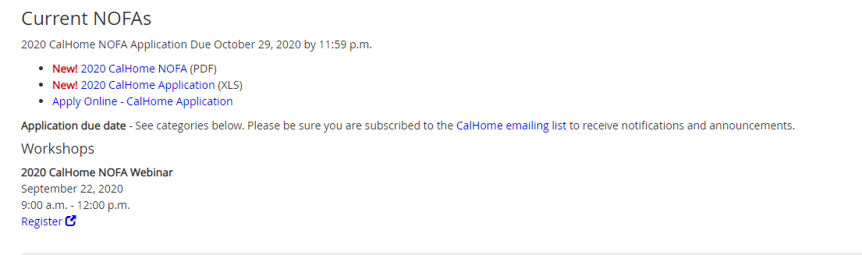
APPLICATION-Portal
Click on the Apply Online- CalHome Application to Access the Application Portal
Screen shot of the Application Portal
Notes:
Kara
Thank you Gail.
There is a new and improved way to complete the 2020 CalHome Application. HCD has created a portal where applicants will enter information about their organization and program or project. This replaces the previous method of applicants submitting binders and USB drives to HCD. The portal is secure and will streamline the application process for applicants.
To access the CalHome Application portal, you will go the HCD website and you will see a tab for Grants and Funding, click on that tab and a drop down will open where you select Programs Active and you will see the CalHome website. Once you are on the CalHome page scroll about half way down the page and you will see Current NOFA’s. That is where you will click on the Apply Online-CalHome Application. This slide has a screen shot of were you click to open the portal. If you find it won’t open in Explorer or Edge use Chrome and it should open right up

Slide 45
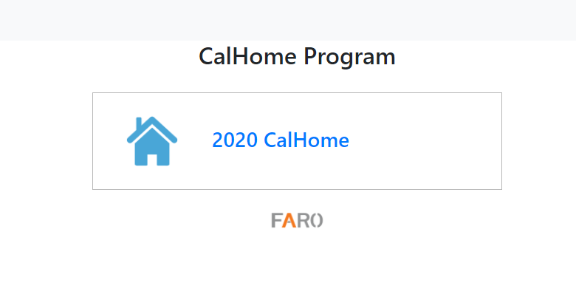
APPLICATION-Portal Landing Page
Screen shot of the Application Portal landing page- select CalHome 2020
Notes:
Kara
When you click on the Apply Online you will see this page. Select the CalHome 2020 Application. From there you will fill out information about your organization and the program or project you are apply for. You will have provided some of the information in the excel application, but please be aware that it is very important for this information to be entered in both the excel application and the portal. We need all of the information to process your application.
The main difference you will see in using the portal versus previous application methods such as binders or USB drives is there is a clearly marked place to identify and upload required documents. This will help you correctly complete your application and prevent applicants from accidently forgetting to submit a required document.

Slide 46
APPLICATION- Key Information
If the area is marked with an asterisk it is required. Please be aware of specific upload formats.
The Excel Application must be submitted in XLS or XLSX format on the portal not XLM (this means the document must be saved removing MACROS).
Once the application is submitted a confirmation receipt will be sent. Save the confirmation.
Notes:
Kara
In the portal if the area is marked with an asterisk it is required. Please be aware of the specific upload formats.
The Excel Application must be submitted in XLS or XLSX format on the portal not XLM (this means the document must be saved removing MACROS).
Once the application is submitted a confirmation receipt will be sent to you. Please save the confirmation receipt as proof of submission.

Slide 47
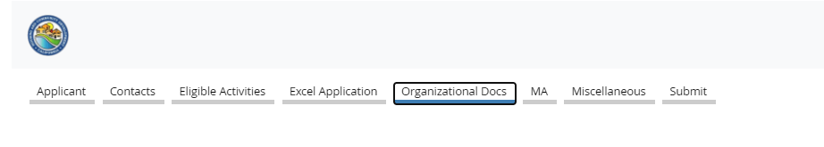
APPLICATION-Portal Required Documents
Screen shot of the Application Portal required document page.
Notes:
Kara
When you select the program or project you are applying for, a customized list of documents will populate the portal, next to the organizational docs tab.
You can see there is a tab for Organization Documents, this tab is a universal tab for all applications. This is where you upload documents such as your Resolution, Service area Map and signature block just to name a few.
In this example, I selected Mortgage Assistance as the program I’m applying for, and the MA tab opened up. If you choose Project Development Loan- that tab would pop up next to the organizational docs.
Please be sure to name your document correctly and upload them to the corresponding box so we know what we are reviewing.

Slide 48
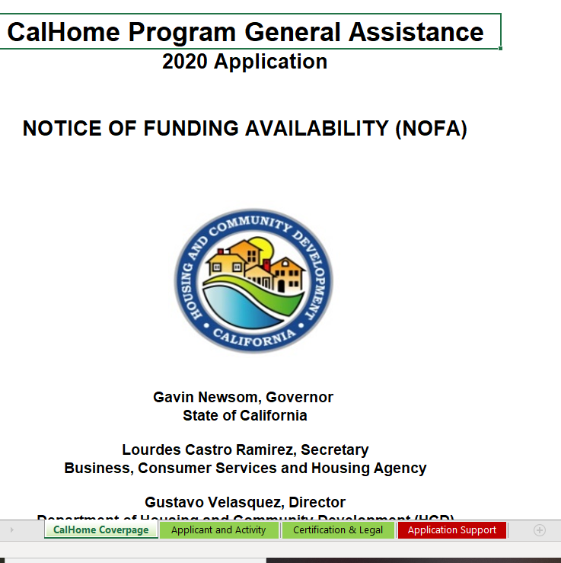
EXCEL APPLICATION
Screen shot of the first page of the CalHome excel application
Notes:
Kara
Now that I’ve reviewed the Portal basics I’m going to review the excel application you will be filling out and uploading to the portal. Please remember that the application portal is not a replacement for the excel application, the excel application needs to be completed in full and uploaded to the application portal with the supporting documents in PDF format.
This is a screen shot of the first page of the Excel application. Click on the applicant and activity tab and start filling out the application. It is very important to enable the excel document. There will be a small box at the top of the document that indicates: enable. Be sure to click on this box to enable the workbook or your application won’t work correctly.

Slide 49
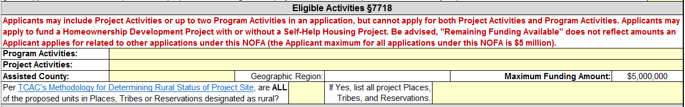
APPLICATION-Activity and Projects
Screen shot of the Eligible Activity tab
Notes:
Kara
In the Applicant and Activity Tab – you will need to enter the Program Activity or Project that you are applying for. Once this information is entered, other worksheet tabs at the bottom of the application will open that will correspond to the activity that is being applied for.
You will also need to enter in the assisted county, geographic region and rural are if it applies. Please note- only one county per application is allowed, if an organization plans on applying for funds in multiple counties they must complete separate applications for each county. It is important to remember that the maximum funding amount per Applicant is $5M, keep this in mind if you are completing multiple applications for your organization. Because the total amount applied for can’t exceed 5 million.

Slide 50
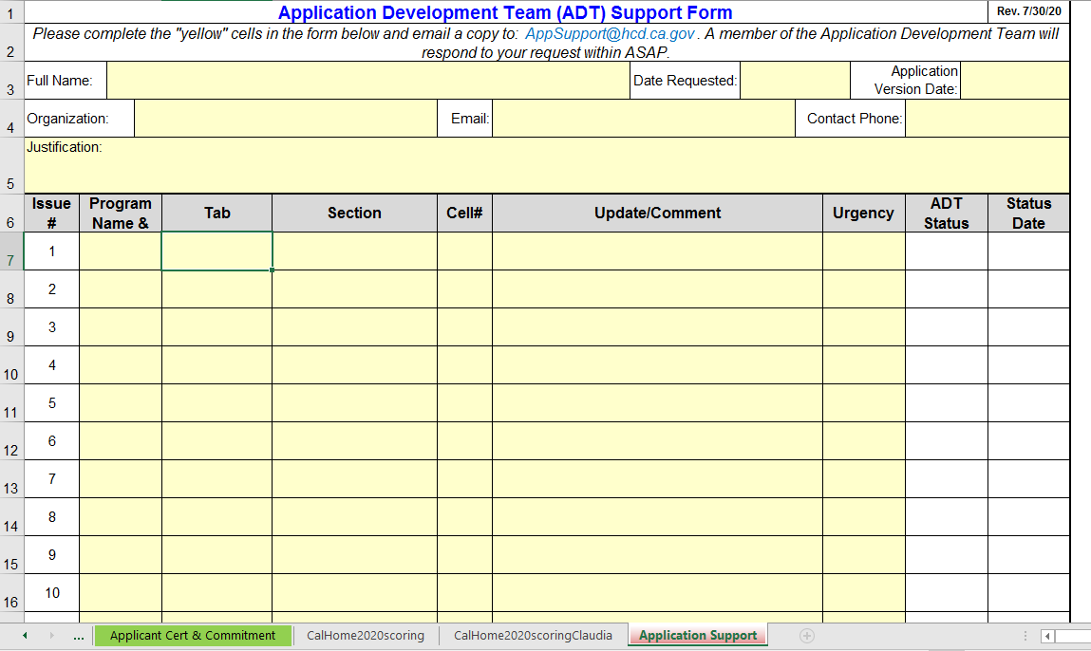
APPLICATION
Screen shot of application support tab
Notes:
Kara
If you find you have questions or need technical assistance with the application template please use the Application Support tab within the excel workbook, and send a copy of your Excel Application with support tab completed to CalHome@hcd.ca.gov. Please note this not for program or guideline questions. We will review your question and respond to you. Please be sure to send only questions related to the CalHome exel application using this method. All other questions should be sent to the CalHome email box.

Slide 51
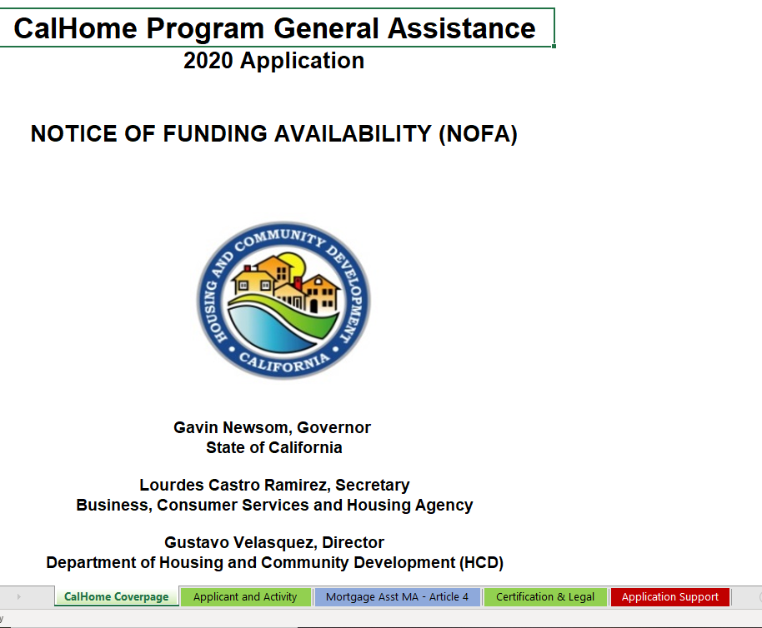
APPLICATION- Applicant Certification and Legal Disclosure
Picture of the Applicant Certification and Legal Disclosure
Notes:
Kara
The application workbook has a tab titled Certification and Legal- this is the Applicant Certification and Legal Disclosure form that all applicants need to complete.

Slide 52
APPLICATION- Tips
The applicant will need to have the appropriate party wet sign the Applicant Certification and Legal Disclosure, then print/scan into PDF format and upload into the portal.
Screen shot of Certification and Legal Disclosure
Screen shot of application certification and legal disclosure on the application portal
Notes:
Kara
The Application Certification and Legal Disclosure page needs a “wet” signature. You will need to print out the Applicant Certification and Legal Disclosure page from the excel application, sign the certification and legal disclosure page then scan it into a PDF document. This document will be uploaded into the Organizational documents tab of the portal. In this slide, you can see the location of where this will be uploaded in the portal.

Slide 53
APPLICATION- Feasibility
If an applicant is applying for Mortgage Assistance, Self-Help Technical Assistance or a Project Development Loan the Feasibility points are dependent on the previous year home sales.
The applicant is requested to submit evidence of previous year home sales, this is for the immediate twelve months preceding the application date. Feasibility points will not be awarded without the provided documentation requested in the application.
Notes:
Kara
If an applicant is applying for Mortgage Assistance, Self-Help Technical Assistance or a Project Development Loan the Feasibility points are dependent on the previous year home sales in your geographic area.
The applicant is requested to submit evidence of previous year home sales, this is for the immediate twelve months preceding the application date.
Feasibility points will not be awarded without the provided documentation requested in the application.

Slide 54
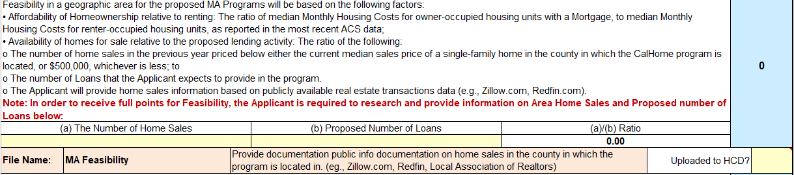
APPLICATION- Home Sales Ratio
Screen shot of the application where home sales and the proposed number of loans are entered.
Notes:
Kara
This slide shows where you will input the number of home sales and the proposed number of loans you will do in the geographic area you are applying in. The ratio will be auto calculated by the application and the score will automatically populate in the scoring matrix. You will then upload documentation of the number of home sales to the portal.

Slide 55
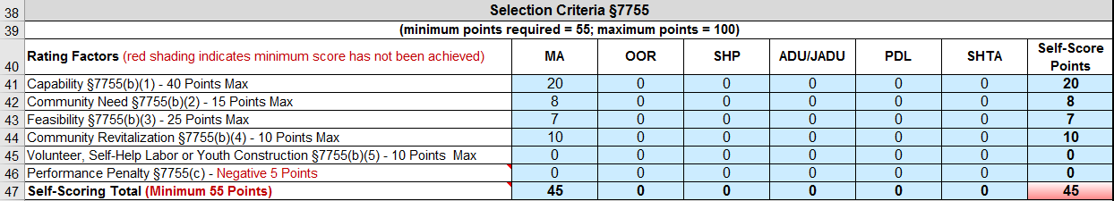
APPLICATION- Score Matrix
Screen shot of score matrix
Notes:
Kara
The points in this table will autofill based on the information provided in the specific activity tabs.
For cells that do not meet the minimum requirements the shading will turn red as seen in row 47, if this happens this applicant would not meet the minimum threshold score of 55. They would need to review their answers and see if they did not fill out the application completely or correctly. Once the self-score points meet or exceed 55 points the applicant then meets the minimum score criteria and can proceed.
You can apply for up to two programs per application, if this is an option you chose, the scores will be averaged. If you would like your programs to be scored individually, you are also allowed to apply for two programs using two separate applications. Please keep in mind that if you apply for 2 programs, the maximum award amount of 5 million applies to the organization, that maximum award amount is not program or project based. This is also true if an organization is applying for multiple counties.

Slide 56
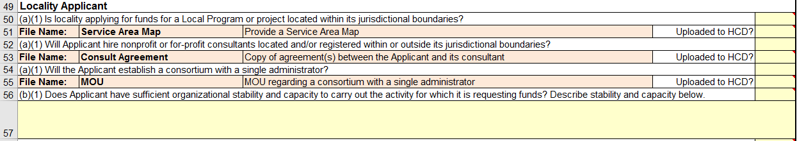
APPLICATION- Tip
Screen shot of small sample of the excel application
Notes:
Kara
Cells shaded in canary yellow require the applicant to provide an answer in the application. It may be a drop down response or a narrative response, please be sure that all yellow cells have an answer.
Keep an eye out for the salmon colored cells, those cells require an answer and an attachment. For example, in the picture above the salmon colored cell for Service Area Map requires you to indicate if this document has been uploaded to the portal. This is an example of how the excel application and portal compliment each other.

Slide 57
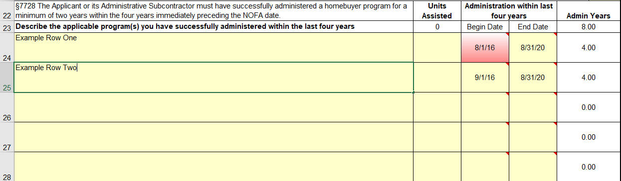
APPLICATION- Experience Tip
Screen shot of experience chart in the excel application
Notes:
Kara
Here is a quick tip for making sure you receive full credit for experience. You can see that in row 22 indicates, The Applicant or its Administrative Subcontractor must have successfully administered a homebuyer program for a minimum of two years within the four years immediately preceding the NOFA date. We are capturing the previous 4 years of experience your organization has in this section.
When inputting years of experience for the most recent four years, if the begin date is prior to the NOFA date’s four year mark the cell will shade red. An example of this is row 24. You can see that the begin date cell with the date 8/1/16 is shaded red, indicating the begin date of your program is not within the four year immediately preceding the NOFA date. You can still submit your application and staff will review and calculate the total number of Admin Years.
But in the row 25, the Begin date is now 9/16/20, and the cell is yellow. This indicates the Begin Date of the program entered is within the four years immediately preceding the NOFA date.

Slide 58
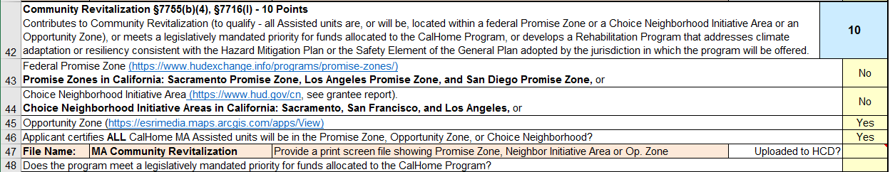
APPLICATION-Community Revitalization
Notes:
Kara
For Community Revitalization points be sure to answer the questions and provide attachments if applicable.
In order to receive the points ALL CalHome Assisted units must be in the designated qualifying area. For example if you answer yes to Opportunity Zone to receive the 10 points for Community Revitalization all of your units must be in the Opportunity Zone. You can’t do some units in the Opportunity Zone and some outside of it. 100% must be done in the Opportunity Zone. This is true for the Promise Zone and the Choice Neighborhood as well.

Slide 59
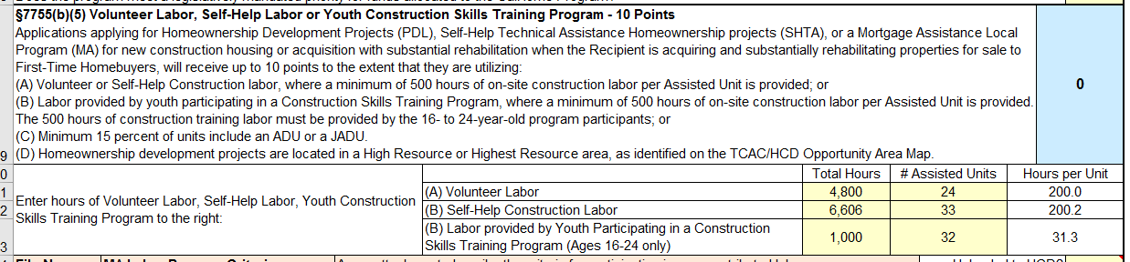
APPLICATION- Volunteer Labor
Screen shot of volunteer labor
Notes:
Kara
Applicants that are utilizing Volunteer, Self-Help Construction Labor, or Youth Construction Skills be sure to complete the hours and total number of assisted units.
Please note only applicants applying for Project Development Loans, Self help technical assistance or Mortgage Assistance for New Construction will be able to utilize this section.

Slide 60
APPLICATION- Performance Penalty
Applicants that have previously received a CalHome Grant will be reviewed for performance under Guidelines Section 7755, subd. (c)). Failure to have expended at least 95 percent of the most recently awarded Grant by the 36th month of the prior CalHome contract (with the exception of funds awarded under the April 11, 2018 CalHome Disaster NOFA and May 3, 2019 CalHome Disaster NOFA) may result in a five point penalty deduction from the score of the application (Guidelines Section 7759, subd. (a)(1)(B)).An Applicant with any project currently in the Department’s compliance resolution unit shall not be eligible to apply (Guidelines Section 7717, subd. (b)(1)).
Screen shot of performance penalty
Notes:
Kara
At the end of the program activity tab there is a designated area to enter a Performance Penalty if it applies. According to the CalHome NOFA: Applicants that have previously received a CalHome Grant will
be reviewed for performance under Guidelines Section 7755, subd. (c)). Failure to have expended at least 95 percent of the most recently awarded Grant by the 36th month of the prior CalHome contract (with the exception of funds awarded
under the April 11, 2018 CalHome Disaster NOFA and May 3, 2019 CalHome Disaster NOFA) may result in a five point penalty deduction from the score of the application (Guidelines Section 7759, subd. (a)(1)(B)).
An Applicant with any project currently in the Department’s compliance resolution unit shall not be eligible to apply (Guidelines Section 7717, subd. (b)(1)).

Slide 61
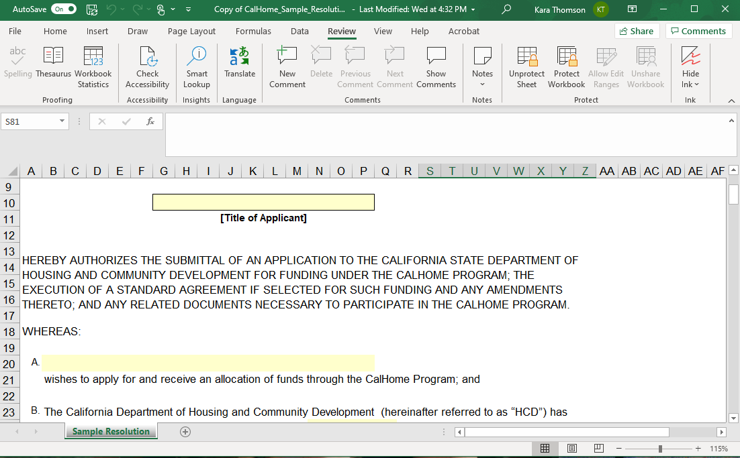
RESOLUTION
Screen shot of the sample resolution
Notes:
Kara
A sample resolution for the CalHome application is available on the HCD Calhome website. You are able to use this document to develop your resolution for the program.
HCD documents are ADA compliant which means automated screen readers will be able to read our documents. Due to the nature of making a document ADA compliant in excel the spread sheet is locked, which can make it difficult to edit. We recognize that you may need to edit this document and you are allowed to do so. But first you will need to unlock the worksheet. This is very easy, go to the review tab at the top of the page and click on unprotect sheet. There is no password required and you will now be able to edit this sheet as needed. This sample resolution can be found on the HCD Cal home webpage.
And now back to Mauro for the conclusion of this workshop!

Slide 62
QUESTIONS
Notes:
Mauro

Slide 63
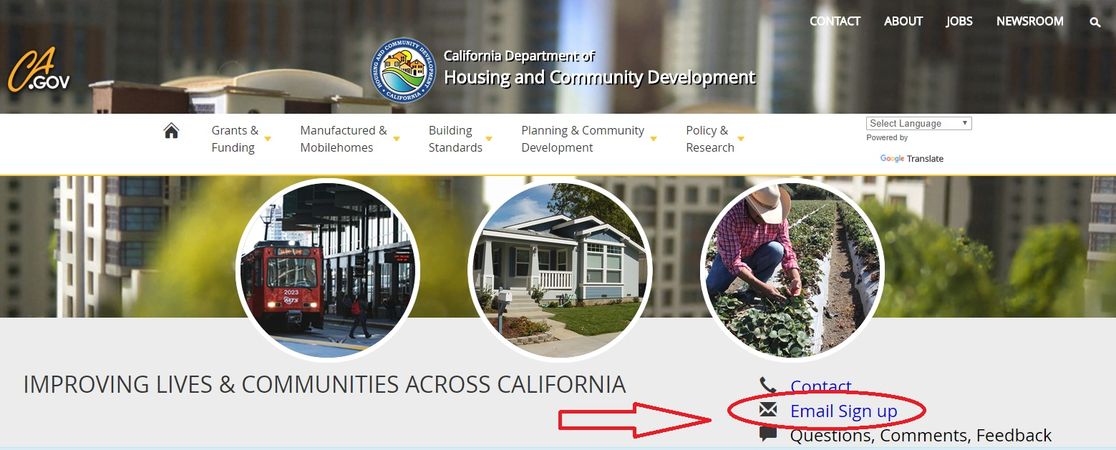
Stay in the know: Sign up for HCD email at www.hcd.ca.gov
Notes:
Mauro

Slide 64



Follow HCD on social media
Like us on Facebook: /CaliforniaHCD
Follow us on Twitter: @California_HCD
Follow us on LinkedIn: /company/californiahcd
Notes:
Mauro

