Slide 1

Fair Housing Data Collection and Affirmative Marketing for Program and Project Activities
State of California HOME and CDBG Programs
CA Department of Housing and Community Development
April 2013

Slide 2
            Part I:
            Program Activities

Slide 3
Policy Goal
HUD’s policy is to administer housing programs affirmatively, so…individuals of similar income levels in the same housing market area have a like range of housing choices available to them regardless of their race, color, religion, sex, handicap, familial status or national origin.

Slide 4
CDBG and HOME Program Activities Demographic Analysis Form
Analyzes demographic make-up of your program applicants, beneficiaries, rejected applicants, and those on the waiting list
Complete with your Annual Report for the previous reporting year (i.e. July 1- June 30)
Complete for each program activity for which you provided assistance, either through a State CDBG or HOME Standard Agreement, PI, or combinations thereof
Keep all completed forms and back-up documentation of marketing efforts on file for 5 years after expiration of your Standard Agreement

Slide 5
Applicable Program Activities
CDBG
  Housing Rehab 1-4
  Homebuyer Assistance
  Public Services
  Microenterprise Loans and Grants
  Microenterprise TA

Slide 6
Applicable Program Activities
HOME
  FTHB Acquisition Only
  FTHB Acquisition with Rehabilitation
  FTHB Infill New Construction
  OOR
  TBRA

Slide 7
How to Analyze the Data
Enter your program applicant, beneficiary, rejected applicant, and wait list data by protected class category
Look for differences of more or less than 10% from the Census data for each protected class category. (Blue “Difference” cells will indicate)

Slide 8
How to Analyze the Data
Differences of more than 10% (e.g. 39%) reflect an overrepresentation of the protected class
Differences of less than 10% (e.g. -39%) reflect and underrepresentation of the protected class
Where there is over-or under-representation by more than 10% the cell will turn red.

Slide 9
FORM EXERCISE
Notes:
Mention form testing was based on a sample of jurisdictions so if your jurisdiction’s population number appears wrong to call us to make sure the form is auto-filling correctly.

Slide 10
Narrative Questions
Goals:
  To understand what your analysis of the data shows, and evaluate these conclusions
  To understand the reasons for any potential problems you have identified
  To understand and evaluate the appropriateness of any current or planned actions you have identified to address significant underrepresentation by protected class

Slide 11
Actions to Address Underrepresentation
Can be marketing/outreach related
Can be changes in program policies or practices which may increase access of underrepresented protected classes.
For example:
  Use of bilingual staff
  Accept applications by means other than just in-person

Slide 12
Targeting Special Needs Populations
Should still strive to have racial and ethnic diversity in the targeted population
Where under-or over representation is due to special needs targeting, you must be able to demonstrate that this is the cause of the disparity, and not other reasons related to discrimination against protected classes.

Slide 13
Questions??

Slide 14
Contact Information:
Program Activities
Contact your CDBG or HOME Representative

Slide 15
PART II:
Project Activities

Slide 16
Affirmative Marketing for Projects
Covers: HOME rental and homebuyer new construction and rehabilitation projects of five or more units
Forms Used for Affirmative Marketing Plan:
  HUD Form 935.2A (Multi-Family Marketing Plan)
  HCD’s Annual Affirmative Marketing Analysis Report (AAMAR)
Notes:
Ensure that those groups least likely to apply for housing are aware of its availability.
(We are not covering HUD’s form for homebuyer project affirmative marketing today)

Slide 17
HUD Form 935.2A
When is this form completed?
New projects: at least 90 days before marketing
Review minimum of every 5 years
Update if there is a change to demographics of County/HMA
Update if demographics of current residents and/or applicants is not equivalent to County/HMA

Slide 18
Developing an effective AFHMP
Analyze demographics of current residents and applicants vs. Project County (HMA)
Identify racial and ethnic groups, persons with disabilities and families with children that are under-represented and therefore “least likely to apply” without affirmative marketing to attract them to this housing opportunity
Devise marketing strategy to attract them
AFHMP is not valid until the State has approved the Plan
Maintain records of Affirmative Marketing actions
Notes:
Maintain Affirmative Marketing Record for a minimum of 5 years.

Slide 19
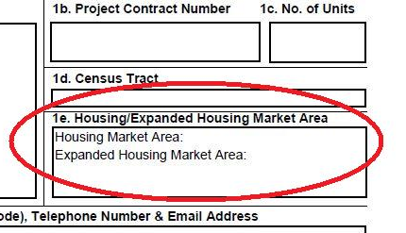
Part 1: Project Background
Blocks 1d-1e: Census Tract & Housing Market Area
  Housing Market Area (HMA): the area from which a project owner/agent may reasonably expect to draw a substantial number of tenants
Notes:
Identify management agent and owner
(Blocks 1f-1g)
Identify person responsible for affirmative marketing certification (Block 1h, Block 9)
Block 2a: initial or update plan + date
Block 2b: type: elderly/family/disabled
Block 2c: date of initial occupancy
Block 2d: advertising start date

Slide 20
Part 1: Project Background
For Affirmative Marketing purposes, HMA should not be smaller than the county
Expanded HMA can be used if project borders 2 or more counties, or when necessary to try to increase the racial and ethnic diversity of the project

Slide 21
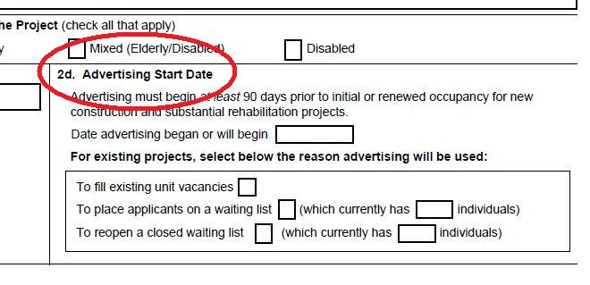
Part 2: Plan Details
Block 2d: Advertising Start Date
  Should be at least 90 days before start of rent-up.
Notes:
Allow a minimum of 30 days for Plan Approval by HCD. (Sometimes there is back and forth discussion around needed changes to the Plan)

Slide 22
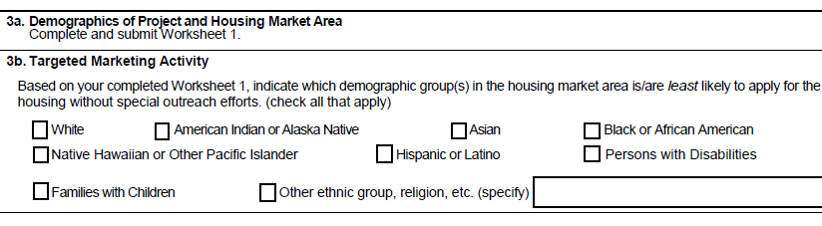
Part 3: Demographics & Marketing
Go to Worksheet 1 for further instructions. Note that the instructions for retrieving Disability Data have changed. See State Annual Affirmative Marketing Report for updated instructions.

Slide 23
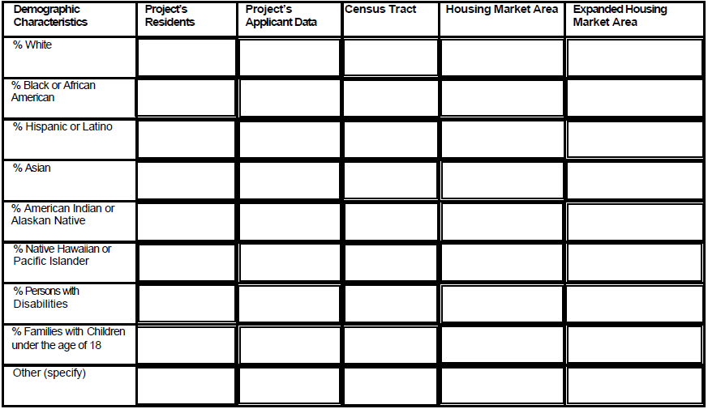
Worksheet 1

Slide 24
Race v. Ethnicity
Race
American Indian/Alaska Native
Asian
Black/African-American
Native Hawaiian/Other Pacific Islander
White
Ethnicity
Hispanic or Latino
Not Hispanic or Latino

Slide 25
Collecting Racial & Ethnic Data
Self-reporting is the preferred method for collecting race & ethnicity data
If the tenant or applicant refuses to self identify, housing staff should use housing records or visual observation in order to gather this data for reporting purposes
Notes:
Usually this data is collected from individuals using HUD’s Ethnicity /Race Data Collection Form (HUD 27061-H), used as part of the Tenant Income Certification (TIC) form.

Slide 26
Identify direction of marketing activity
HUD generally considers a deviation of 10% or more from the HMA/County to be a significant under-or over-representation (dependent upon project size and number of residents/applicants)
Based on completed Worksheet 1, check under-represented groups in Block 3b of AFHMP form

Slide 27
Worksheet 1: % Examples
 | Tenants | Applicants | Census Tract | HMA | Expanded HMA
White | 60 | 35 | 50 | 25
Black | 20 | 40 | 25 | 50
Hispanic | 35 | 30 | 10 | 50
Asian | 10 | 15 | 10 | 15
Indian/Alaskan | 5 | 5 | 10 | 5
Pacific Islander | 5 | 5 | 5 | 5
Disabled | 100 | 100 | 20 | 20
Families with Children | 30 | 50 | 30 | 30
Other | 1 | 5 | 0 | 0
Notes:
Explain where there may be problems with over or under-representation by more than 10% in HMA based on these numbers
(e.g. White tenants over represented; black tenants underrepresented; Hispanic tenants and applicants underrepresented)
100% disability representation may be ok, depending on the requirements of your financing sources, although HUD is moving away from allowing high percentages of units to be restricted to disabled in one project in favor of integration of disabled into general population projects.
Note: in some areas, Whites can be the under-represented racial group to which affirmative marketing efforts should be directed.

Slide 28
Worksheet 1: Common Mistakes
Race categories do not add up to 100%
Among the collected applicant and tenant race data, the “Other” category is over 1% without further explanation
“Familial Status” or “Disability” category is listed as “N/A” when the data is actually available for the county
Using outdated 2000 Census data
Using old 935.2A Form
Notes:
Instructions for retrieving Familial Status and Disability Data can be found on HCD’s Annual Affirmative Marketing Report, (to be discussed later.) Instructions on HUD’s form are no longer correct due to changes in the Census Bureau’s website.

Slide 29
Identify Outreach & Marketing Programs
For each protected class identified as under-represented in Block 3b, identify an outreach or marketing campaign that will be effective in attracting applications from that group.

Slide 30
Worksheets 3 & 4: Marketing and Outreach
Worksheet 3: Identify community contact organization (at least 1 required / 2 recommended for each under-represented group, include specific contact person, previous experience working with target population, date of contact, role)
Worksheet 4: Identify methods of advertising (media used, languages, alternative formats)

Slide 31
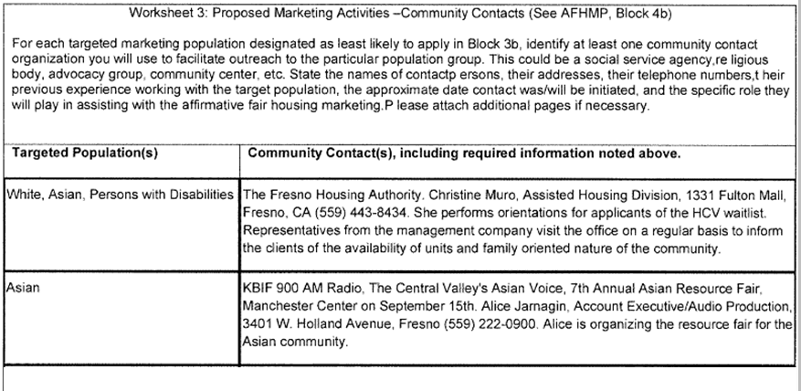
Worksheet 3
Notes:
Review examples above of appropriate community contacts.
Common problems – contacts lacking specific name, address, or phone.

Slide 32
Worksheet 4:
Marketing & Outreach
If groups you’re targeting for affirmative marketing are Limited English Proficient, use multi-lingual materials/ads
Include FHEO logo, slogan, or statement
Attach copies of ads/flyers to your AFHMP when you submit to HCD

Slide 33
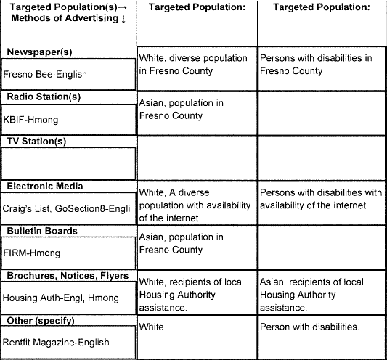
Worksheet 4: Sample
Notes:
Review examples above of various marketing techniques appropriate for the target populations.
Remind people to provide all information requested on the form itself.

Slide 34
Residency Preference (Block 4a)
Residency preferences may have discriminatory impact if demographics of local community vary significantly from those of the HMA. For this reason, they are rarely approved.
Complete Block 4a and Worksheet 2 if you have or propose to use a residency preference.
If development uses something other than direct-marketing to obtain tenants (e.g., county mental health referral system), be sure to indicate that on the form, but remember that it doesn’t release you from the requirement to affirmatively further through identifying under-served groups by race or familial status, conducting outreach & marketing and/or adjusting methods of administration that may be limiting participation.

Slide 35
Evaluation of Affirmative Marketing (Block 6)
Include narrative statement of effectiveness of affirmative marketing techniques – if prior affirmative marketing wasn’t particularly successful in attracting new applications from under-represented groups, describe how you have adjusted your affirmative outreach & marketing strategy to make it more effective with your revised plan.

Slide 36
Questions??

Slide 37
Annual Affirmative Marketing Analysis Report (AAMAR) For Project Activities
Multifamily Rental Projects (5 or more units) must submit the AAMAR each year:
  For CHDO Rental Projects, owner/agent submits to HCD-AMC as a part of the Annual Report.
  For State Recipient Rental Projects, owner/agent submits it to the State Recipient.

Slide 38
Annual Affirmative Marketing Analysis Report For Project Activities
Section I -- Census/Resident/Applicant Data
  Housing Market Area should never be smaller than the County
  Expanded Housing Market Area is specified only in rare instances
  Census Lookup Instructions updated March 2013, for persons with disabilities data
  Census table mirrors Worksheet 1, but also includes data on rejected applicant pool.
Notes:
Complete EHMA, for example, when a project borders two or more counties.

Slide 39
Annual Affirmative Marketing Analysis Report For Project Activities
Section VII – Owner / Property Manager’s Demographic Analysis
  Low representation of any protected group, including any racial group, must be addressed.
  Generally a deviation of 10% or more is considered significant under-representation.
Notes:
Any race is a protected group and if under-represented must be addressed

Slide 40
Contact Information: Project Activities
Projects under Development :
  CHDO: Laura.Bateman@hcd.ca.gov
  SR: Your local jurisdiction, or your HOME representative if you are State Recipient
  Existing Projects:
  CHDO: AMC HOME Representative
  SR: Your local jurisdiction, or Bob.Doyel@hcd.ca.gov if you are a State Recipient

Slide 41
Questions??

Slide 42
Retrieving Census Disability Data
Demonstration
(Time Permitting)

