Slide 1
Creating Jobs for Low-Income Individuals & Businesses
Section 3 of the Housing & Urban Development Act of 1968

Slide 2
Overview
History/Purpose
What is Section 3?
Applicability
Definition of Section 3 Resident & Business
Recipient Responsibilities
Section 3 Reporting Requirements
Best Practices & Common Findings of Non-Compliance
2
Notes:
2

Slide 3
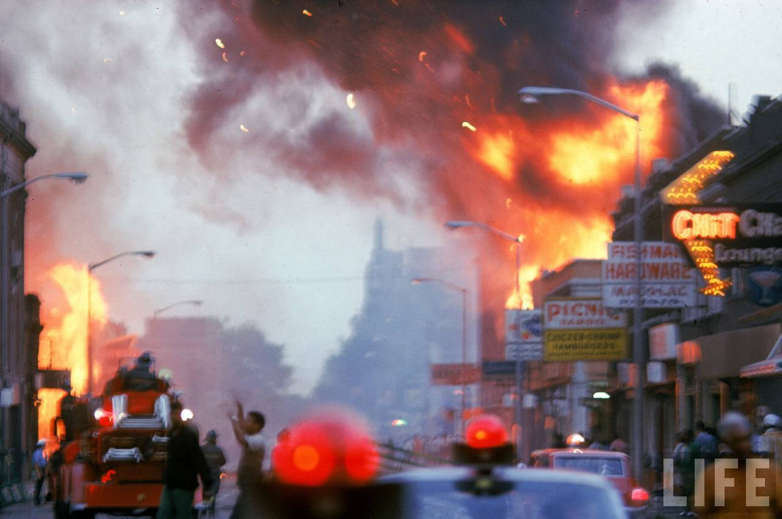
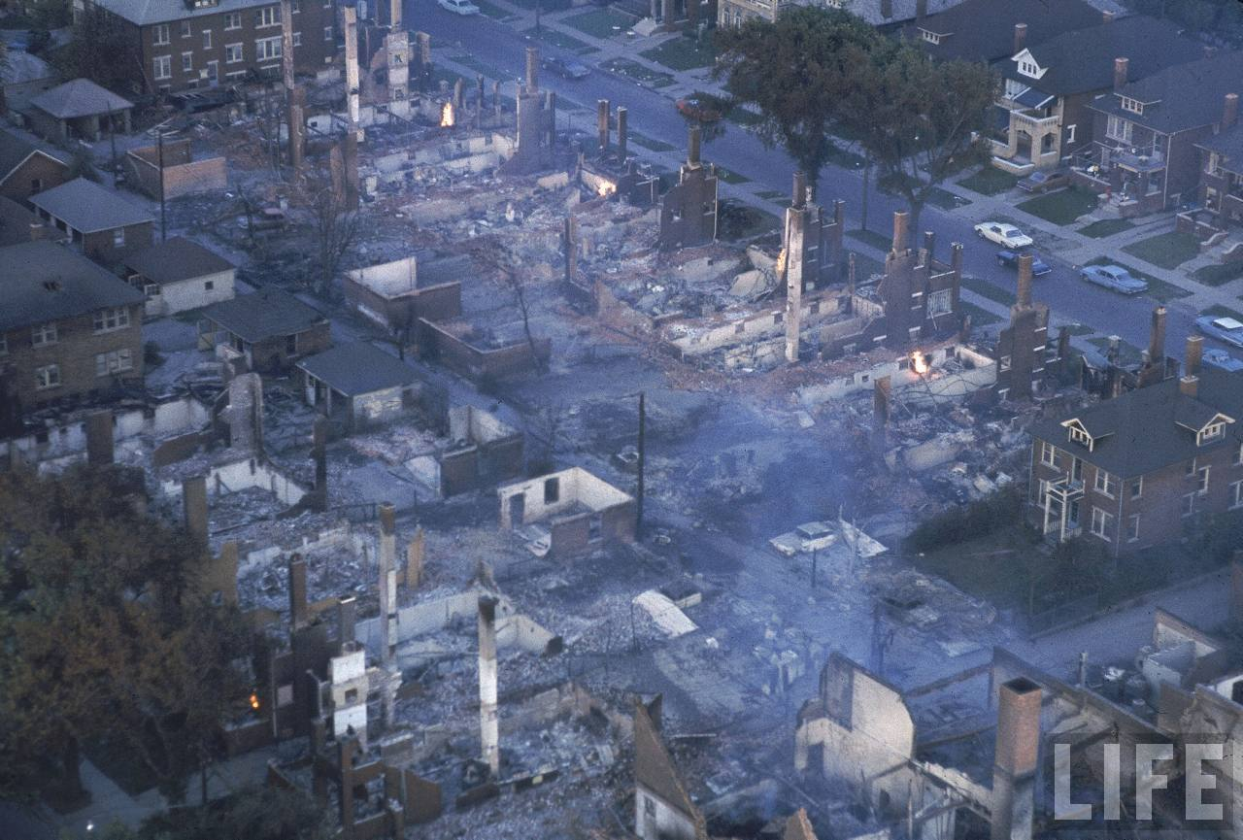
History
1967 Detroit Race Riots
Kerner Commission Report
Housing & Urban Development Act of 1968

Slide 4
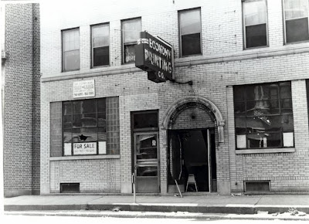
The Blind Pig at 12th St. and Claremont Ave. in Detroit

Slide 5
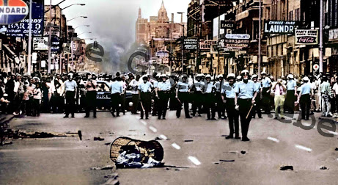
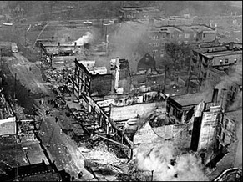
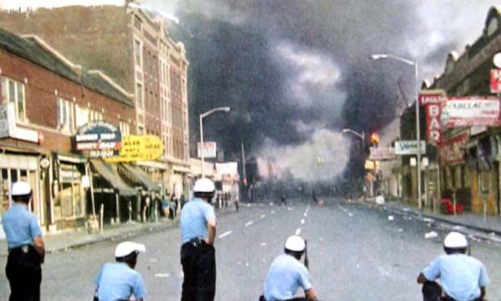

Slide 6
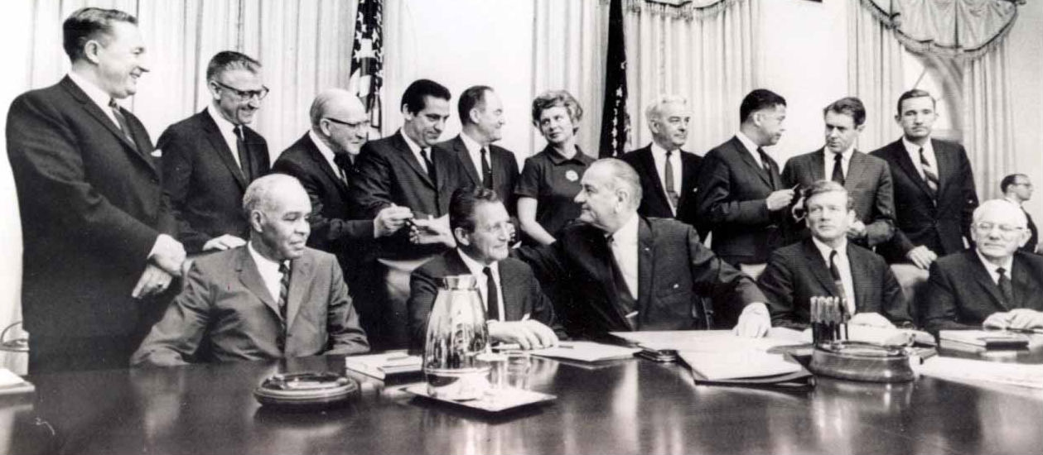
“Physician’s warning of approaching death, with a prescription for life.”
Martin Luther King, Jr., on the findings of
the Kerner Commission Report

Slide 7
The Housing & Urban Development Act of 1968

Slide 8
Section 3 of the Housing & Urban Development Act
…employment and other economic opportunities generated by Federal financial assistance for housing and community development programs shall, to the greatest extent feasible, be directed toward low- and very low-income persons, particularly those who are recipients of government assistance for housing.
- 12 U.S.C. 1701u

Slide 9
Section 3 Applicability
Housing & Community Development Assistance
Housing Construction & Rehabilitation
Architectural, Engineering & Professional Services
Management & Administrative Support
Other Public Construction

Slide 10
Section 3 Applicability: Funding Thresholds
Recipients of $200,000 or more of HUD Housing and Community Development Assistance (CDBG, HOME, ESG)
- 24 C.F.R. § 135.3

Slide 11
Example
The City of Warren’s HUD assistance:
$130,000 in CDBG funds
$120,000 in HOME funds
The City of Warren’s construction-related projects:
$25,000 for Park Improvement, paid for using CDBG funds
Does Section 3 apply to the Park Improvement Project?

Slide 12
Section 3 Applicability: Contractors
The requirements apply to Contracts/Subcontracts in excess of $100,000
Contractors receiving contracts exceeding $100,000 are required to comply in the same manner as direct recipients
If the threshold of $200,000 is met for the projects but no contract of $100,000 is awarded, the requirements only apply to the recipient
12

Slide 13
Section 3 Applicability: Entire Project
Section 3 requirements apply to the entire project or activity regardless if the project is fully or partially funded with covered financial assistance.
13

Slide 14
Section 3 Applicability: CDBG/HOME/ESG
If Section 3 applies, a recipient or contractor is obligated to direct, to the greatest extent feasible, new hires and contracts to Section 3 residents & business concerns.
Who are Section 3 residents & business concerns?
What does “the greatest extent feasible” mean?

Slide 15
Section 3 Resident
Public Housing Resident,
or
A resident of metro area or non metro county in which the Section 3 covered assistance is expended, and who qualifies as a low- or very low-income person.
§ 135.5

Slide 16
Section 3 Business Concern
51% or more owned by Section 3 Residents, or
30% of employed staff are Section 3 Residents; or
25% of subcontracts committed to Section 3 Businesses.
§ 135.5

Slide 17
Section 3 Qualifications
A Section 3 resident must meet the qualifications of the position to be filled.
§135.34(c)
A Section 3 business concern must have the ability and capacity to perform contract.
§135.34(a)(2)
Notes:
17

Slide 18
Section 3 Preference
Section 3 of the HUD act is race and gender neutral.
Hiring/Contracting Preference is based on income and location.
Not MBE/WBE

Slide 19
Recipient Responsibilities: Greatest Extent Feasible
In order to direct economic opportunities, to the greatest extent feasible, to low and very-low income individuals & businesses, recipients of HUD funding are expected to do the following…

Slide 20
Recipient Responsibilities: Preference
Provide hiring preference to Section 3 residents (Priority Consideration)
Assist with achieving compliance among contractors
Facilitate training and employment of residents (Priority Consideration)

Slide 21
Recipient Responsibilities
Notify covered contractors and incorporate the Section 3 clause into contracts
Found at 24 C.F.R. § 135.38
Award contracts to Section 3 Businesses (Priority Consideration)

Slide 22
Recipient Responsibilities: Notification
Notify Section 3 residents and business concerns about economic opportunities (i.e. hiring & contract bids)…examples:
Post Job/Contract Notices at Public Housing Sites
Form partnerships with community organizations that work with low-income job seekers
Work with local trade unions to identify businesses that qualify as Section 3 business concerns

Slide 23
Recipient Responsibilities: Numerical Goals
Meet annual numerical goals
30% of new hires annually
10% of the total dollar amount of covered construction contracts
Safe Harbor: Recipient is considered compliant if numerical goals are met (unless proof exists to the contrary)

Slide 24
Section 3 Reporting
Recipients of HUD funding must annually submit HUD Form 60002.
Even when Section 3 does not apply.
Measures efforts to meet annual numerical goals
Narrative explanations
Failure to meet numerical goals
Other Actions taken to achieve compliance

Slide 25
Section 3 Reporting: Determining Compliance
If minimum numerical goals (safe harbor) are not met, each recipient bears the responsibility to explain why it was not possible
Entering all zeros on the form without a valid explanation is considered noncompliance.

Slide 26
Section 3 Reporting: Due Date for CDBG/HOME
Due Date: Section 3 Report should be submitted on the same day your CAPER is due.
Submit via online reporting system

Slide 27
Section 3: Common Findings of Non-Compliance
Failure to incorporate Section 3 requirements into internal hiring policy or bid solicitation processX
Failure to make best effort to award contracts to Section 3 business concernsX
Failure to meet numerical goals or provide narrative report explaining why numerical goals could not be metX
Failure to monitor contractors’ compliance with Section 3
Failure to incorporate Section 3 clause in contract documents

